Slide 1
SNACK ORDERING AND DELIVERY APP
By
Abinaya Devadarshini D (7155221040102)
Karthika S (715522104027)
Madhumitha T (715522104031)
Sangamithra Saravanan (715522104045)

Slide 2
DESCRIPTION
The FoodShades app is for smooth and fun food ordering with numerous convenience features. It allows secure login to the account using a phone number, Google account, or an email ID. The app helps streamline navigation through a large variety of the food items, adding/removing items from the cart as many times as one wishes. It offers easy ordering as all selected items appear in a cart so that one can view them before ordering. One can easily specify their desired delivery location inside the app so that their order is efficiently fulfilled. It also provides for options for payments, such as UPI, Paytm, Razorpay, and Cash on Delivery, so as to ensure choosing the appropriate payment method from the list of acceptable payment methods. Besides, users have the ability to view and comment on foods, hence establishing a community of feedbacks and recommendations. The app gives users an option of accessing a Help & Support page completely focused on support that clients may require in solving any issues arising during the use of the FoodShades app.
This will offer several necessary features in the admin panel to manage all the operations and orders. In the menu account, creation or logging-in processes will be safely done so as to log in to the dashboard of an admin. Using the panel, new items may be created on the menu with the name, description, price, and image and check or update existing ones changing their available quantities accordingly. Admin can update his profile with basic information like name, email, and password. He will have a display of pending orders for approval so that administrators can accept them and dispatch the same to the kitchen for preparation. Orders completed are logged for review, complete history of all the orders received from the app. It also covers income and revenue understanding, and the administrator can track through each status of an order from when it is placed up to its completion in managing and with transparent tracking throughs.

Slide 3
ORDERING

Slide 4
Main Activity.Java
package com.example.project.Activity;
import android.content.Intent;
import android.os.Bundle;
import android.view.View;
import android.widget.Button;
import android.widget.LinearLayout;
import androidx.appcompat.app.AppCompatActivity;
import androidx.recyclerview.widget.LinearLayoutManager;
import androidx.recyclerview.widget.RecyclerView;
import com.example.project.Adapter.CategoryAdapter;
import com.example.project.Adapter.PopularAdapter;
import com.example.project.Domain.CategoryDomain;
import com.example.project.Domain.FoodDomain;
import com.example.project.R;
import com.example.project.databinding.ActivityMainBinding;
import com.google.android.material.floatingactionbutton.FloatingActionButton;
import com.google.firebase.auth.FirebaseAuth;

Slide 5
import java.util.ArrayList; public class MainActivity extends AppCompatActivity { ActivityMainBinding binding; FirebaseAuth auth; Button ordernow; private RecyclerView.Adapter adapter, adapter2; private RecyclerView recyclerViewCategoryList, recyclerViewPopularList;
@Override
protected void onCreate(Bundle savedInstanceState) {
super.onCreate(savedInstanceState);
binding = ActivityMainBinding.inflate(getLayoutInflater());
setContentView(binding.getRoot());
auth = FirebaseAuth.getInstance();
ordernow = findViewById(R.id.ordernow);
// logout = findViewById(R.id.logoutbtn);
ordernow.setOnClickListener(new View.OnClickListener() {
@Override
public void onClick(View view) {
startActivity(new Intent(MainActivity.this, CartListActivity.class)); }
});

Slide 6
recyclerViewCategory(); recyclerViewPopular(); bottomNavigation(); }
private void bottomNavigation() {
FloatingActionButton floatingActionButton = findViewById(R.id.card_btn);
LinearLayout homeBtn = findViewById(R.id.homeBtn);
LinearLayout profilebtn = findViewById(R.id.profilebtn);
floatingActionButton.setOnClickListener(new View.OnClickListener() {
@Override
public void onClick(View v) {
startActivity(new Intent(MainActivity.this, CartListActivity.class));
}
});
homeBtn.setOnClickListener(new View.OnClickListener() {
@Override
public void onClick(View v) {
startActivity(new Intent(MainActivity.this, MainActivity.class));
}
});

Slide 7
/* profilebtn.setOnClickListener(new View.OnClickListener() { @Override public void onClick(View v) { startActivity(new Intent(MainActivity.this, MyProfileActivity.class)); } });*/}
private void recyclerViewPopular() {
LinearLayoutManager linearLayoutManager = new LinearLayoutManager(this, LinearLayoutManager.HORIZONTAL, false);
recyclerViewPopularList = findViewById(R.id.recyclerView2);
recyclerViewPopularList.setLayoutManager(linearLayoutManager);
ArrayList<FoodDomain> foodlist = new ArrayList<>();
foodlist.add(new FoodDomain("Pepperoni pizza", "pizza1", "slices pepperoni ,mozzarella cheese, fresh oregano, ground black pepper, pizza sauce", 399.0));
foodlist.add(new FoodDomain("Cheese Burger", "burger", "Gouda Cheese, Special sauce, Lettuce, tomato ", 50.0));
foodlist.add(new FoodDomain("Vegetable pizza", "pizza2", " olive oil, Vegetable oil, pitted Kalamata, cherry tomatoes, fresh oregano, basil", 199.0));
foodlist.add(new FoodDomain("Vegetable pizza", "pizza4", " olive oil, Vegetable oil, pitted Kalamata, cherry tomatoes, fresh oregano, basil", 199.0));

Slide 8
adapter2 = new PopularAdapter(foodlist); recyclerViewPopularList.setAdapter(adapter2); }
private void recyclerViewCategory() {
LinearLayoutManager linearLayoutManager = new LinearLayoutManager(this, LinearLayoutManager.HORIZONTAL, false);
recyclerViewCategoryList = findViewById(R.id.recyclerView);
recyclerViewCategoryList.setLayoutManager(linearLayoutManager);
ArrayList<CategoryDomain> categoryList = new ArrayList<>();
categoryList.add(new CategoryDomain("Pizza", "cat_1"));
categoryList.add(new CategoryDomain("Burger", "cat_2"));
categoryList.add(new CategoryDomain("Hotdog", "cat_3"));
categoryList.add(new CategoryDomain("Drink", "cat_4"));
categoryList.add(new CategoryDomain("Dount", "cat_5"));
adapter = new CategoryAdapter(categoryList);
recyclerViewCategoryList.setAdapter(adapter);}

Slide 9
public void profile(View view) { startActivity(new Intent(MainActivity.this, ProfileActivity.class)); }
public void support(View view) {
startActivity(new Intent(MainActivity.this, SupportActivity.class));
}
public void setting(View view) {
startActivity(new Intent(MainActivity.this, SettingActivity.class));
}
}

Slide 10
Activity_main.xml
<?xml version="1.0" encoding="utf-8"?>
<androidx.constraintlayout.widget.ConstraintLayout xmlns:android="http://schemas.android.com/apk/res/android"
xmlns:app="http://schemas.android.com/apk/res-auto"
xmlns:tools="http://schemas.android.com/tools"
android:layout_width="match_parent"
android:focusable="true"
android:focusableInTouchMode="true"
android:layout_height="match_parent"
tools:context=".Activity.MainActivity">
<ScrollView
android:id="@+id/scrollView2"
android:layout_width="match_parent"
android:layout_height="match_parent"
app:layout_constraintBottom_toBottomOf="parent"
app:layout_constraintEnd_toEndOf="parent"

Slide 11
app:layout_constraintStart_toStartOf="parent" app:layout_constraintTop_toTopOf="parent">
<LinearLayout
android:layout_width="match_parent"
android:layout_height="wrap_content"
android:orientation="vertical"
android:paddingBottom="90dp">
<androidx.constraintlayout.widget.ConstraintLayout
android:layout_width="match_parent"
android:layout_height="wrap_content">
<androidx.recyclerview.widget.RecyclerView
android:id="@+id/recyclerView2"
android:layout_width="match_parent"
android:layout_height="wrap_content"
android:clipToPadding="false"
android:paddingStart="22dp"

Slide 12
android:paddingEnd="22dp" app:layout_constraintEnd_toEndOf="parent" app:layout_constraintHorizontal_bias="0.0" app:layout_constraintStart_toStartOf="parent" app:layout_constraintTop_toBottomOf="@+id/textView10" />
<TextView
android:id="@+id/textView10"
android:layout_width="wrap_content"
android:layout_height="wrap_content"
android:layout_marginStart="40dp"
android:layout_marginTop="16dp"
android:text="Popular"
android:textColor="#000000"
android:textSize="18sp"
android:textStyle="bold"
app:layout_constraintStart_toStartOf="parent"
app:layout_constraintTop_toBottomOf="@+id/recyclerView" />

Slide 13
<TextView android:id="@+id/textView4" android:layout_width="wrap_content" android:layout_height="wrap_content" android:layout_marginStart="32dp" android:layout_marginTop="32dp“ android:text="Hi User" android:textColor="@color/startcolorgradient" android:textSize="20sp" android:textStyle="bold" app:layout_constraintStart_toStartOf="parent" app:layout_constraintTop_toTopOf="parent" />
<TextView
android:id="@+id/textView5"
android:layout_width="wrap_content"
android:layout_height="wrap_content"
android:layout_marginTop="8dp"
android:text="Order &amp; Eat"
android:textColor="#000000"

Slide 14
android:textSize="20sp" app:layout_constraintEnd_toEndOf="@+id/textView4" app:layout_constraintHorizontal_bias="0.0" app:layout_constraintStart_toStartOf="@+id/textView4" app:layout_constraintTop_toBottomOf="@+id/textView4" />
<ImageView
android:id="@+id/imageView3"
android:layout_width="39dp"
android:layout_height="37dp"
android:layout_marginEnd="32dp"
android:src="@drawable/fslogo2"
app:layout_constraintBottom_toBottomOf="@+id/textView5"
app:layout_constraintEnd_toEndOf="parent"
app:layout_constraintTop_toTopOf="@+id/textView4"
app:layout_constraintVertical_bias="0.2" />

Slide 15
<androidx.constraintlayout.widget.ConstraintLayout android:id="@+id/constraintLayout" android:layout_width="match_parent" android:layout_height="150dp" android:layout_marginStart="32dp" android:layout_marginEnd="32dp" android:background="@drawable/light_orange_back" app:layout_constraintBottom_toBottomOf="parent" app:layout_constraintEnd_toEndOf="parent" app:layout_constraintHorizontal_bias="0.0" app:layout_constraintStart_toStartOf="parent" app:layout_constraintTop_toBottomOf="@+id/textView5" app:layout_constraintVertical_bias="0.073">
<ImageView
android:id="@+id/imageView4"
android:layout_width="wrap_content"
android:layout_height="wrap_content"
android:src="@drawable/image_banner"
app:layout_constraintBottom_toBottomOf="parent"
app:layout_constraintStart_toStartOf="parent" />

Slide 16
<TextView android:id="@+id/textView6" android:layout_width="wrap_content" android:layout_height="wrap_content" android:layout_marginTop="16dp" android:text="Free Delivery" android:textColor="#000000" android:textSize="20sp" android:textStyle="bold" app:layout_constraintStart_toEndOf="@+id/imageView4" app:layout_constraintTop_toTopOf="@+id/imageView4" />
<TextView
android:id="@+id/textView7"
android:layout_width="wrap_content"
android:layout_height="wrap_content"
android:layout_marginEnd="2dp"
android:text="Mar 26 - Mar 30"
android:textColor="#000000"
android:textSize="18sp"
app:layout_constraintEnd_toEndOf="@+id/textView6"
app:layout_constraintStart_toStartOf="@+id/textView6"
app:layout_constraintTop_toBottomOf="@+id/textView6" />

Slide 17
<androidx.constraintlayout.widget.ConstraintLayout android:layout_width="90dp" android:layout_height="24dp" android:layout_marginTop="8dp" android:background="@drawable/custom_button" app:layout_constraintBottom_toBottomOf="parent" app:layout_constraintEnd_toEndOf="@+id/textView7" app:layout_constraintStart_toEndOf="@+id/imageView4" app:layout_constraintTop_toBottomOf="@+id/textView6">
<Button
android:id="@+id/ordernow"
android:layout_width="wrap_content"
android:layout_height="wrap_content"
android:layout_marginStart="16dp"
android:layout_marginTop="8dp"
android:layout_marginEnd="16dp"
android:layout_marginBottom="8dp"
android:background="@drawable/custom_button"
android:text="Order Now"
android:textColor="#ffffff"

Slide 18
app:layout_constraintBottom_toBottomOf="parent" app:layout_constraintEnd_toEndOf="parent" app:layout_constraintStart_toStartOf="parent" app:layout_constraintTop_toTopOf="parent" /> </androidx.constraintlayout.widget.ConstraintLayout> </androidx.constraintlayout.widget.ConstraintLayout>
<TextView
android:id="@+id/textView9"
android:layout_width="wrap_content"
android:layout_height="wrap_content"
android:layout_marginStart="32dp"
android:layout_marginTop="16dp"
android:text="Categories"
android:textColor="#000000"
android:textSize="18sp"
android:textStyle="bold"
app:layout_constraintStart_toStartOf="parent"
app:layout_constraintTop_toBottomOf="@+id/constraintLayout" />

Slide 19
<TextView android:id="@+id/textView8" android:layout_width="wrap_content" android:layout_height="wrap_content" android:text="FoodShades" android:fontFamily="cursive" android:textStyle="bold" android:textSize="16dp" android:textColor="@color/startcolorgradient" app:layout_constraintBottom_toBottomOf="@+id/textView5" app:layout_constraintEnd_toEndOf="@+id/imageView3" app:layout_constraintStart_toStartOf="@+id/imageView3" />
</androidx.constraintlayout.widget.ConstraintLayout>
</LinearLayout>
</ScrollView>

Slide 20
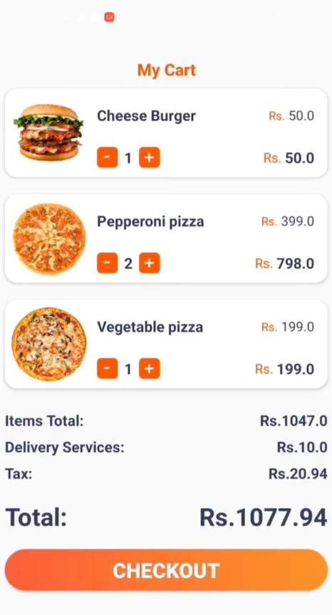
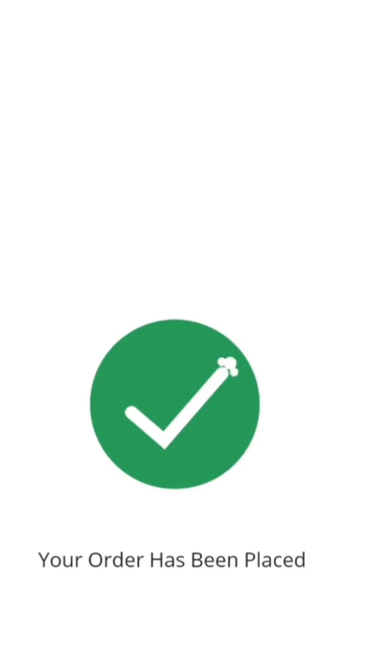
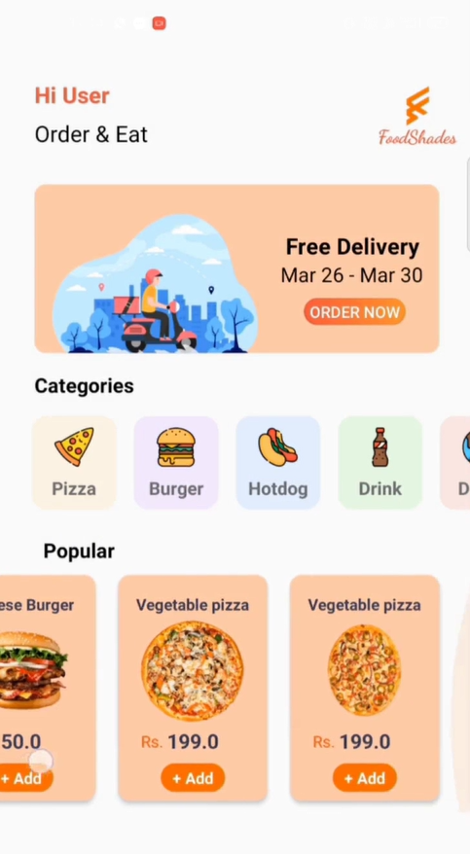
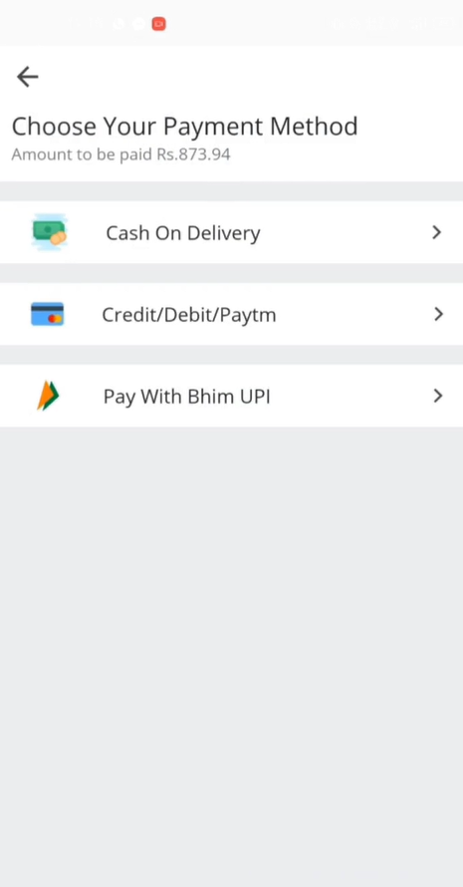
Output:

Slide 21
DELIVERY

Slide 22
Main Activity.java
package com.example.adminsweeto
import android.content.Intent
import androidx.appcompat.app.AppCompatActivity
import android.os.Bundle
import com.example.adminsweeto.databinding.ActivityMainBinding
import com.example.adminsweeto.model.OrderDetails
import com.google.firebase.auth.FirebaseAuth
import com.google.firebase.database.DataSnapshot
import com.google.firebase.database.DatabaseError
import com.google.firebase.database.DatabaseReference
import com.google.firebase.database.FirebaseDatabase
import com.google.firebase.database.ValueEventListener

Slide 23
class MainActivity : AppCompatActivity() { private val binding : ActivityMainBinding by lazy { ActivityMainBinding.inflate(layoutInflater) } private lateinit var database: FirebaseDatabase private lateinit var auth: FirebaseAuth private lateinit var completedOrderReference: DatabaseReference
override fun onCreate(savedInstanceState: Bundle?) {
super.onCreate(savedInstanceState)
setContentView(binding.root)
auth = FirebaseAuth.getInstance()
binding.addMenu.setOnClickListener{
val intent = Intent (this,AddItemActivity::class.java)
startActivity(intent) }
binding.allItemsMenu.setOnClickListener {
val intent = Intent (this,AllItemActivity::class.java)
startActivity(intent)
}

Slide 24
binding.outForDelivery.setOnClickListener { val intent = Intent (this,OutForDeliveryActivity::class.java) startActivity(intent) } binding.profile.setOnClickListener { val intent = Intent (this,AdminProfileActivity::class.java) startActivity(intent) }
binding.createUser.setOnClickListener {
val intent = Intent (this,CreateUserActivity::class.java)
startActivity(intent) }
binding.pendingOrderText.setOnClickListener {
val intent = Intent (this,PendingOrdersActivity::class.java)
startActivity(intent) }
binding.logOutButton.setOnClickListener {
auth.signOut()
startActivity(Intent(this,LoginActivity::class.java))
finish()
}

Slide 25
pendingOrder() completedOrders() wholeTimeEarning() }
private fun wholeTimeEarning() {
val listOfTotalPay = mutableListOf<Int>()
completedOrderReference = FirebaseDatabase.getInstance().reference.child("CompletedOrder")
completedOrderReference.addListenerForSingleValueEvent(object : ValueEventListener{
override fun onDataChange(snapshot: DataSnapshot) {
for (orderSnapshot in snapshot.children){
var completeOrder = orderSnapshot.getValue(OrderDetails::class.java)
completeOrder?.totalPrice?.replace("₹","")?.toIntOrNull()
?.let { i ->
listOfTotalPay.add(i)
} }
binding.wholeTimeEarning.text = listOfTotalPay.sum().toString() + "₹"
}

Slide 26
override fun onCancelled(error: DatabaseError) {} }) }
private fun completedOrders() {
val completedOrderReference = database.reference.child("CompletedOrder")
var completedOrderItemCount = 0
completedOrderReference.addListenerForSingleValueEvent(object : ValueEventListener{
override fun onDataChange(snapshot: DataSnapshot) {
completedOrderItemCount = snapshot.childrenCount.toInt()
binding.completedOrderCount.text = completedOrderItemCount.toString()
}
override fun onCancelled(error: DatabaseError) {}
})
}

Slide 27
private fun pendingOrder() { database = FirebaseDatabase.getInstance() val pendingOrderReference = database.reference.child("OrderDetails") var pendingOrderItemCount = 0
pendingOrderReference.addListenerForSingleValueEvent(object : ValueEventListener{
override fun onDataChange(snapshot: DataSnapshot) {
pendingOrderItemCount = snapshot.childrenCount.toInt()
binding.pendingOrderCount.text = pendingOrderItemCount.toString()
}
override fun onCancelled(error: DatabaseError) {}
})
}
}

Slide 28
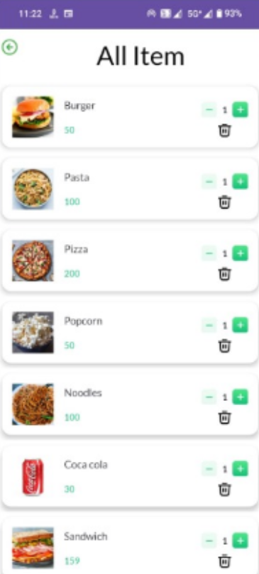
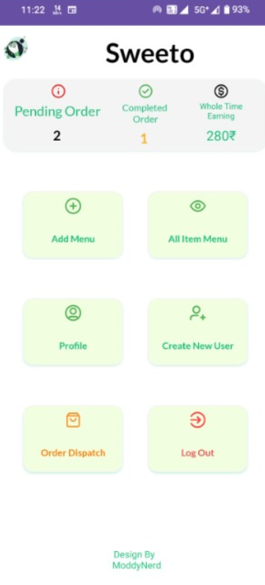
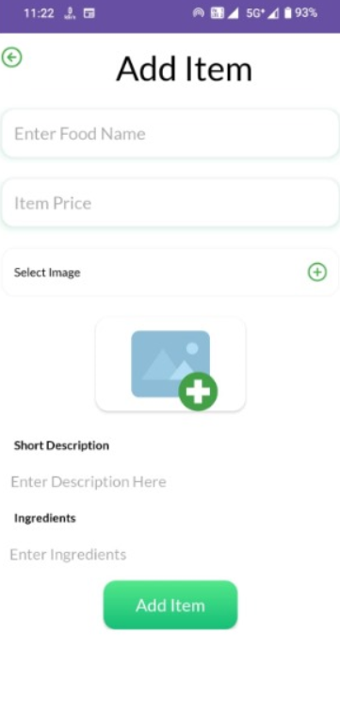
Output:

Slide 29
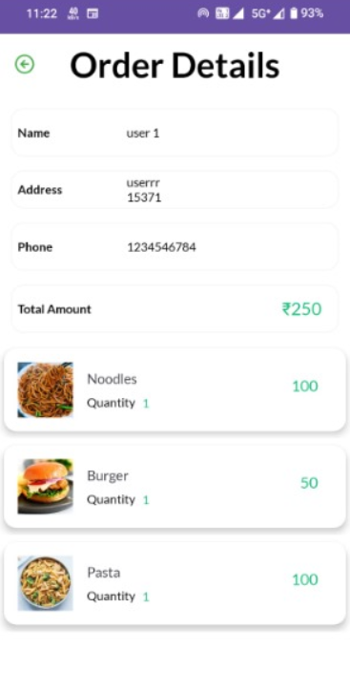
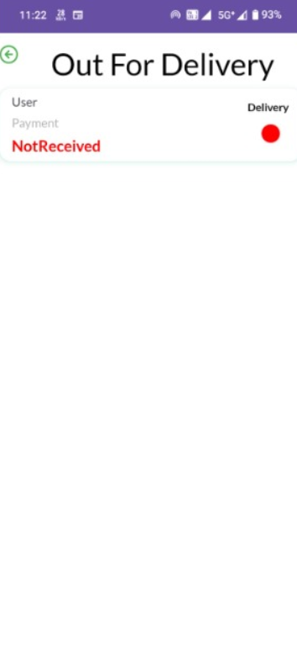
Output:

